Slide 1


IAIA Final Project 2024
IAIA Project #2
Automatic Ade Cafe Robot Using Deep
Learning and Robotic Arms
School of Mechanical and Control Engineering
Sunwoo Kim(22000090)
Sion Seo(21800360)
Hojin Jang(22100645)
24.12.20
Industrial AI and Automation
Prof. Young-Keun Kim

Slide 2
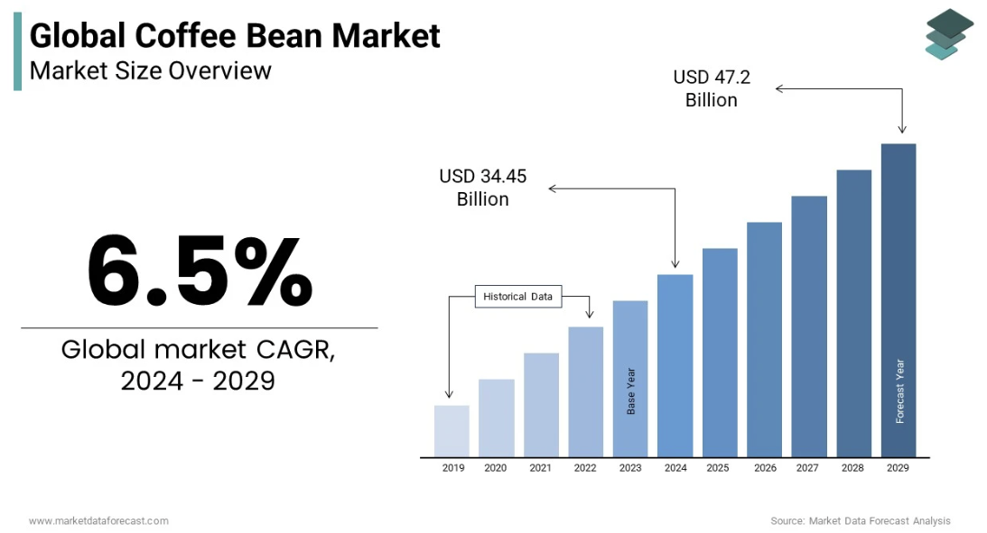
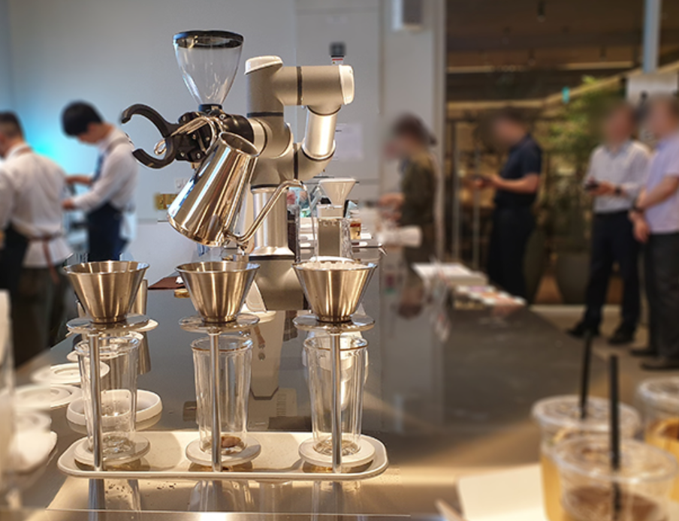

1. Background
1) Background
Global cafe market is growing steadily, expected to reach 47.2 billion dollar within 5 years
Drinks are not quantitative & accuracy follow as worker.
2) Problem
Change the accuracy & quantitative of drink follow as worker
low work efficiency (Training period to worker: 3 months)
3) Requirement
Perform the task exactly within the specified sampling time (make drink about 40 to 50 seconds)
Robot must be able to determine the amount of material in stock and replace it

Slide 3
2. Goal
Goal
Establishment of beverage delivery automation system
Specific goal
Judgment of the amount of syrup through image recognition
Quantitative Beverage Supply Using Flow Dispenser
Perform the task exactly within the specified sampling time

Slide 4
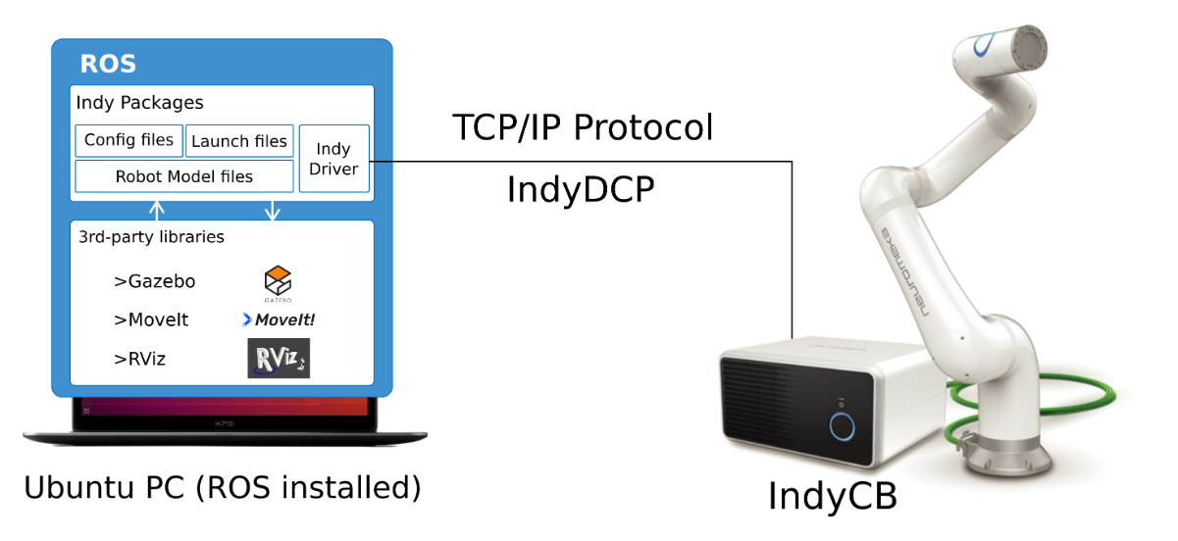
3. Connect with ROS
Interworking is essential before proceeding with the project
Packages required to control the Indy robot in ROS
External libraries integrated with ROS.
Structures of communication and control systems using Indy10 and Ubuntu based Robot Operating System (ROS) environments conducted in this project

Slide 5
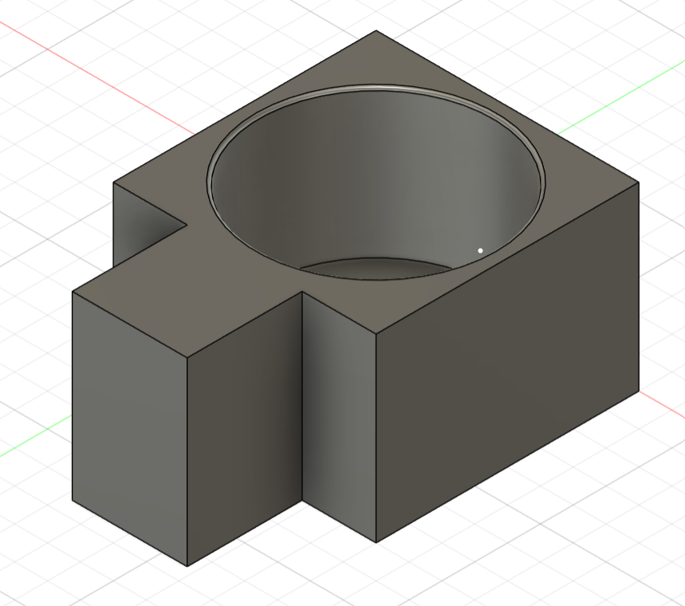
4. Gripper Design
The design of Gripper to carry out the project is essential
1. Purpose
- To hold beverage containers.
2. Reason for Use
1. Nede for a stand during syrup dispensing
▪A stable stand is required to dipnse syrup into a specific container.
2. Preventing cup deformation when using a gripper
▪Directly gripping the cup with a gripper may cause structural damage to the cup

Slide 6
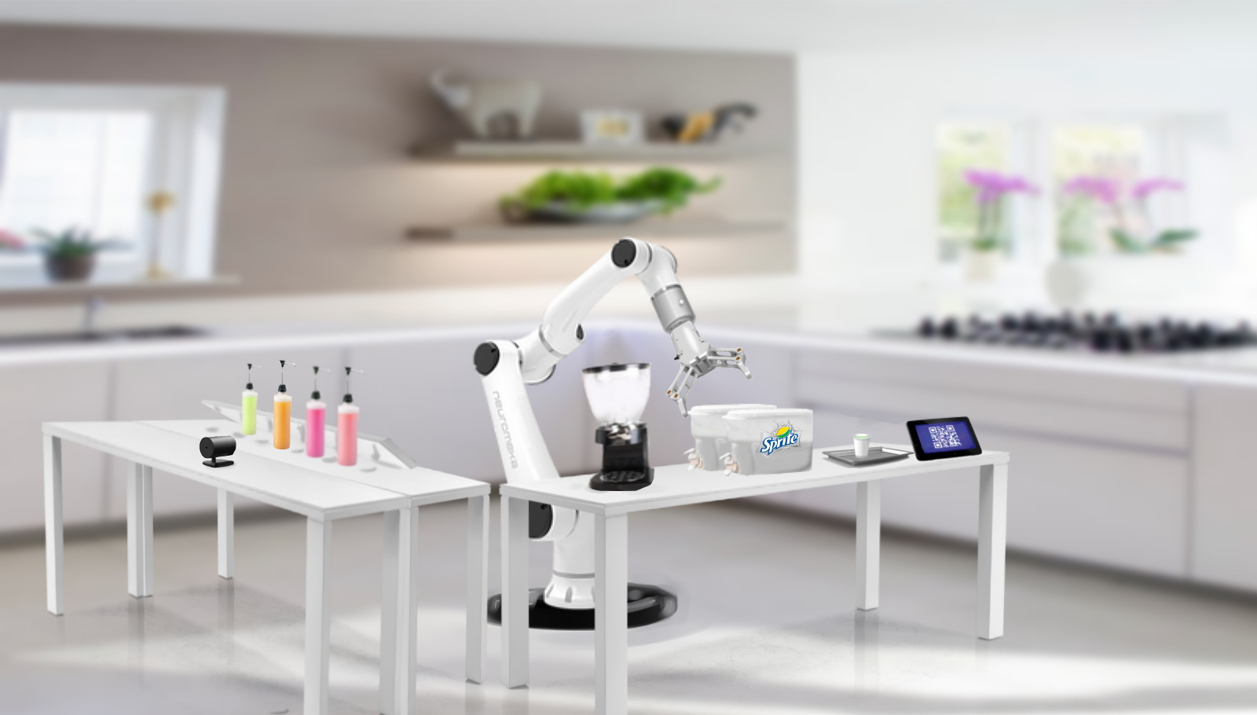
4. Environment
1. QR - Code
2. Cyrup
3. Ice - dispencer
4. Cider - dipencer
1
2
3
4

Slide 7

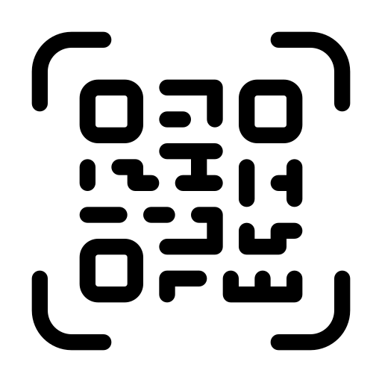

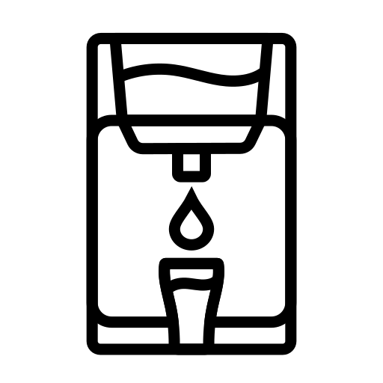
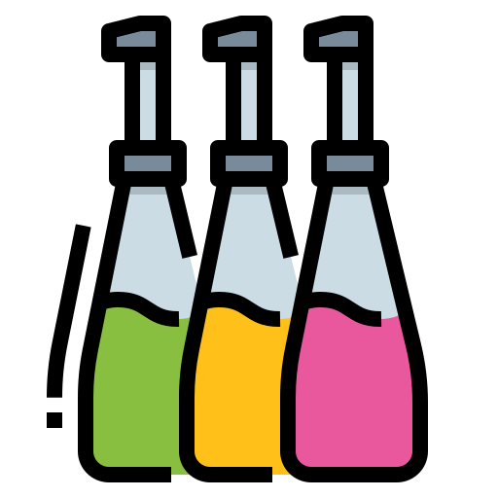
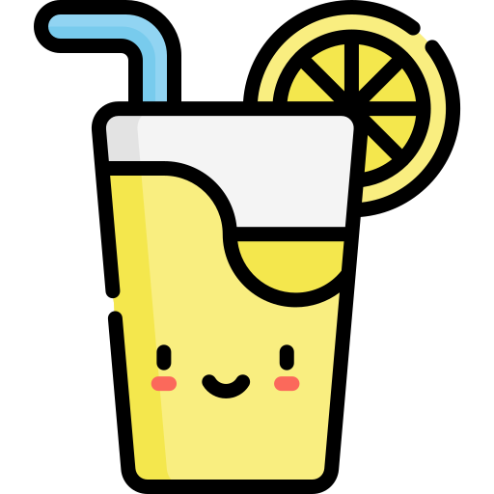


5. Process
Using Image processing
- QR classifier
- bottle classifier
Drink type
order
5. Offering finished beverage
2. Add syrup recognized by QR code
4. Add cider to a cup of syrup and ice
1. Order drink using QR code
3. Add ice to the syrup-added cup

Slide 8
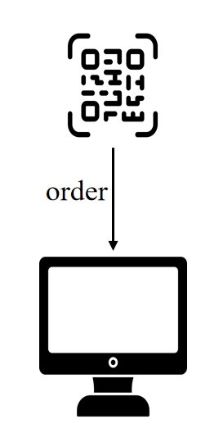
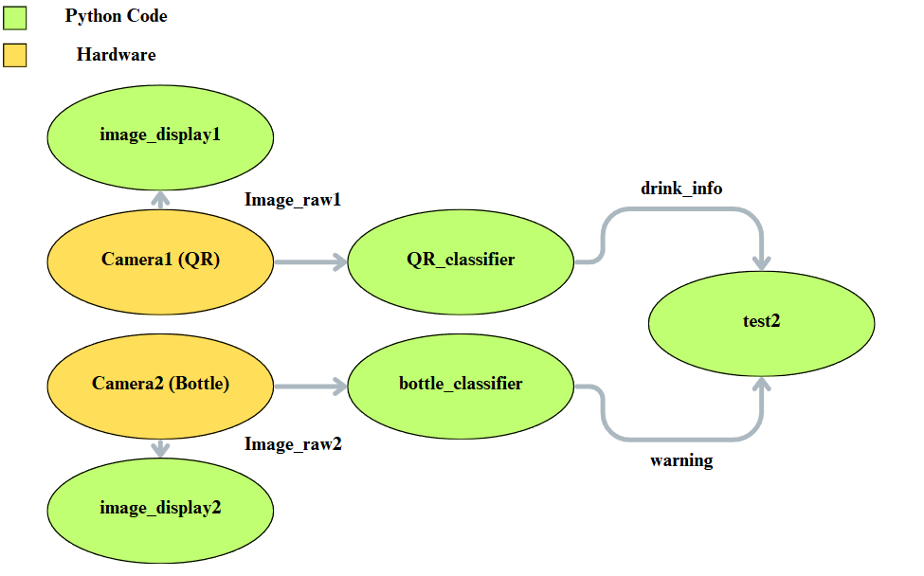
5. Progress
Drink order procedure using QR classifier & bottle classifier

Slide 9
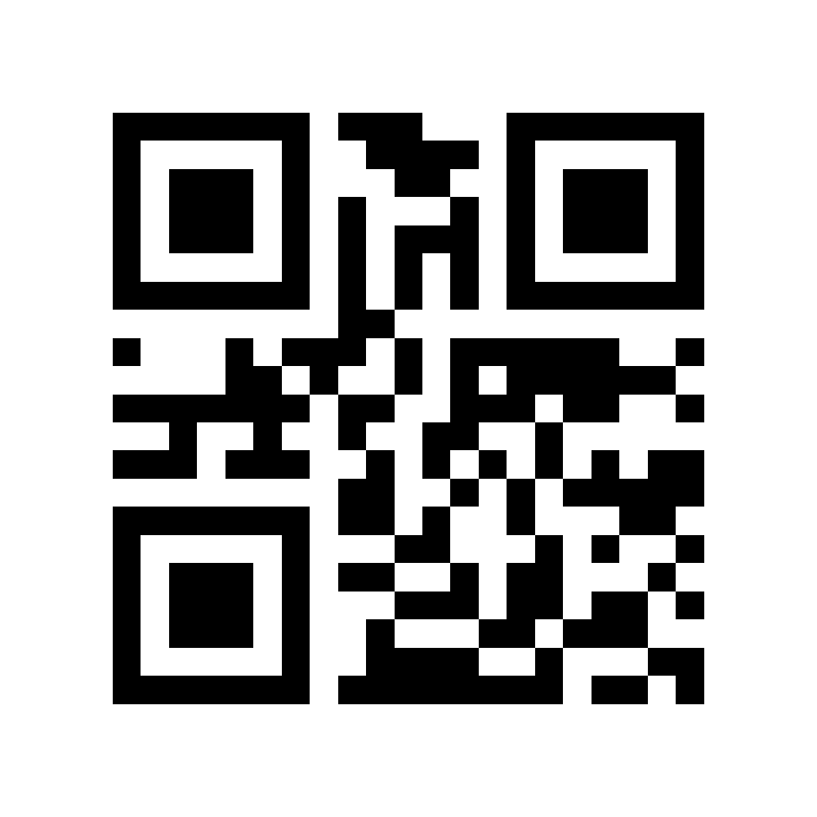
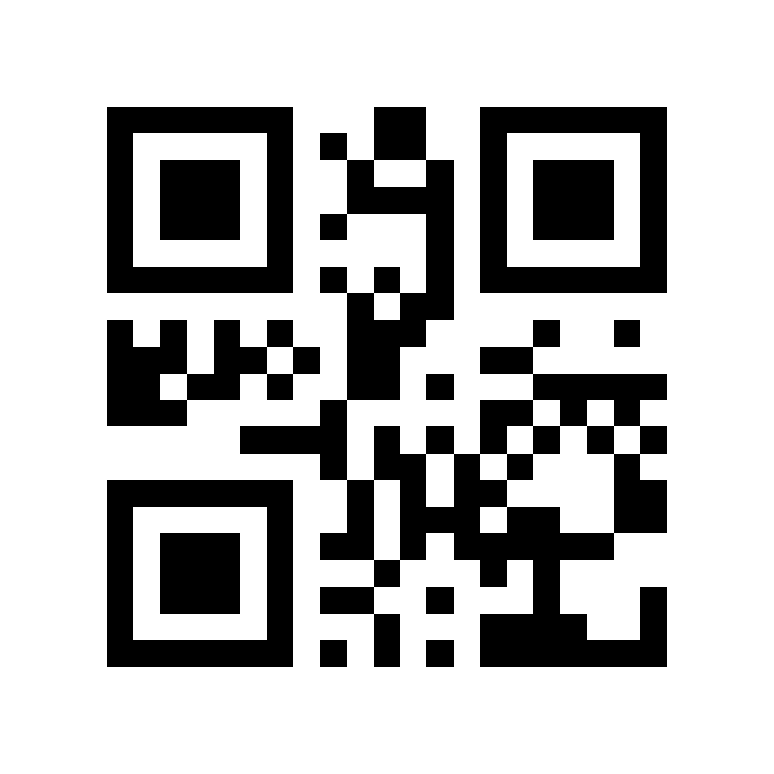
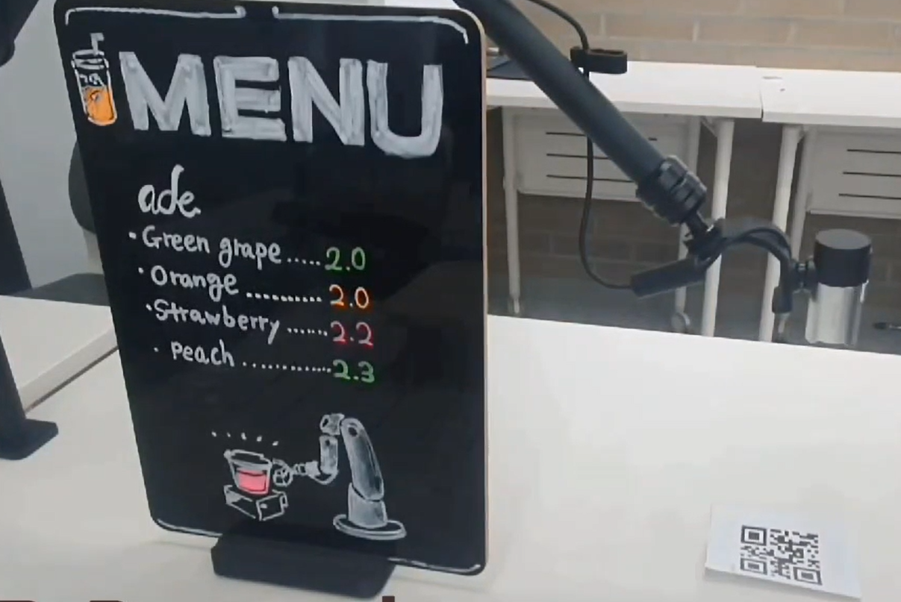
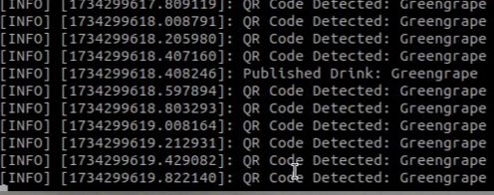
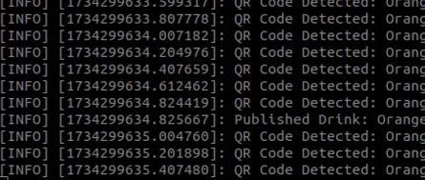
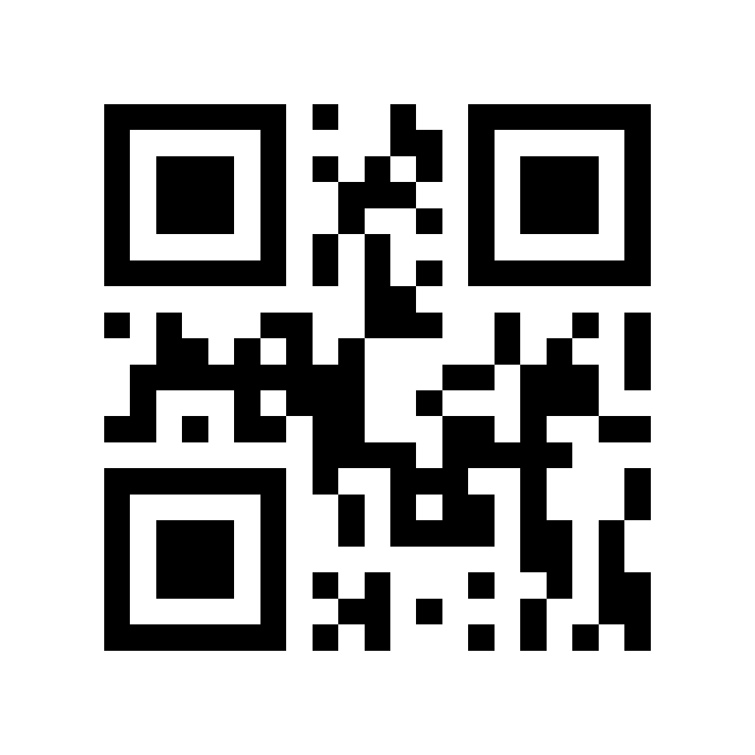
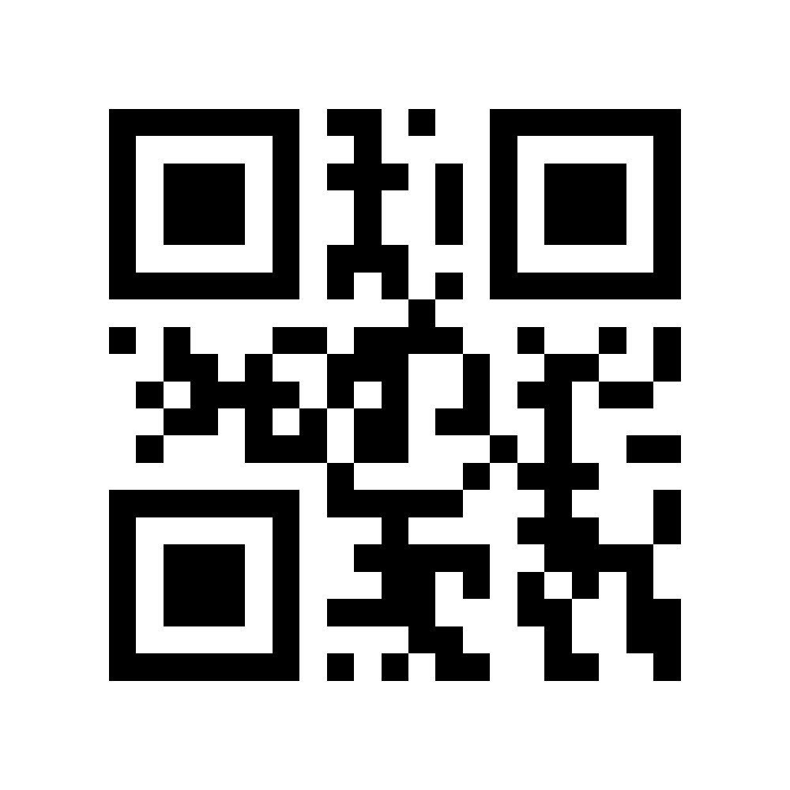
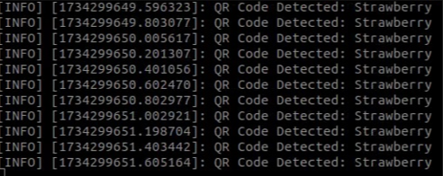
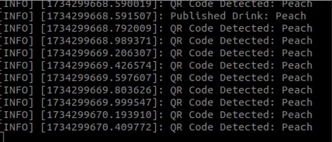
5. Progress
QR classifier
4-type syrup Recognize
1. Greengrape | 2. Orange
3. strawberry | 4. Peach
Use webcam and pyzar program to recognize QR

Slide 10
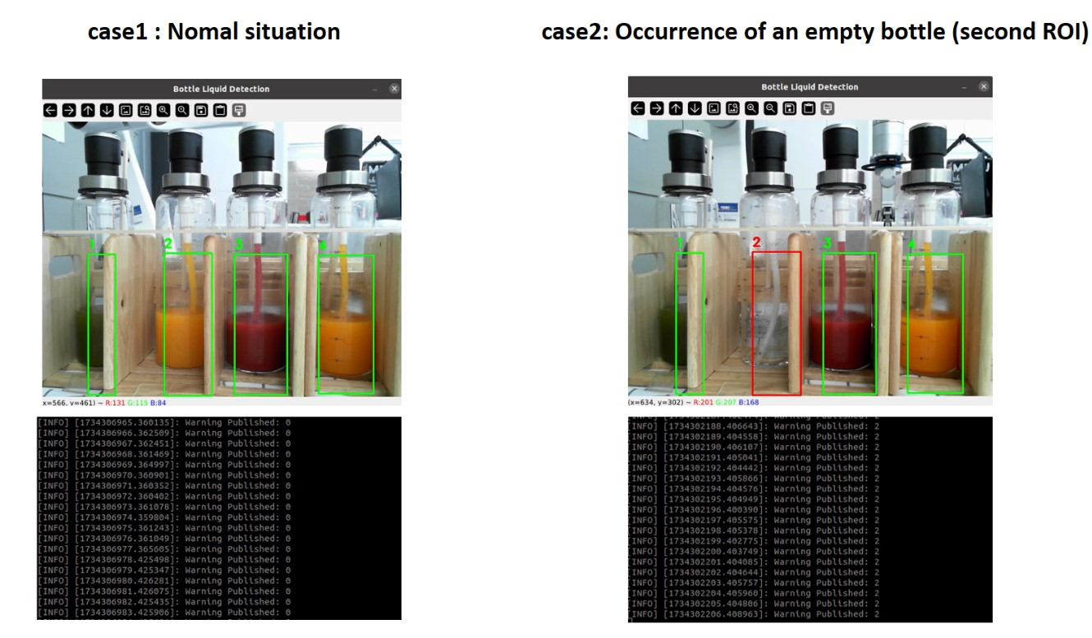
5. Progress
bottle classifier
Use ROI and HSV to detect the empty bottle and output the message for the empty bottle
Case1: Normal condition (not aware of an empty bottle)
Case2: Empty bottle occurrence (empty bottle detected in bottle 2)

Slide 11
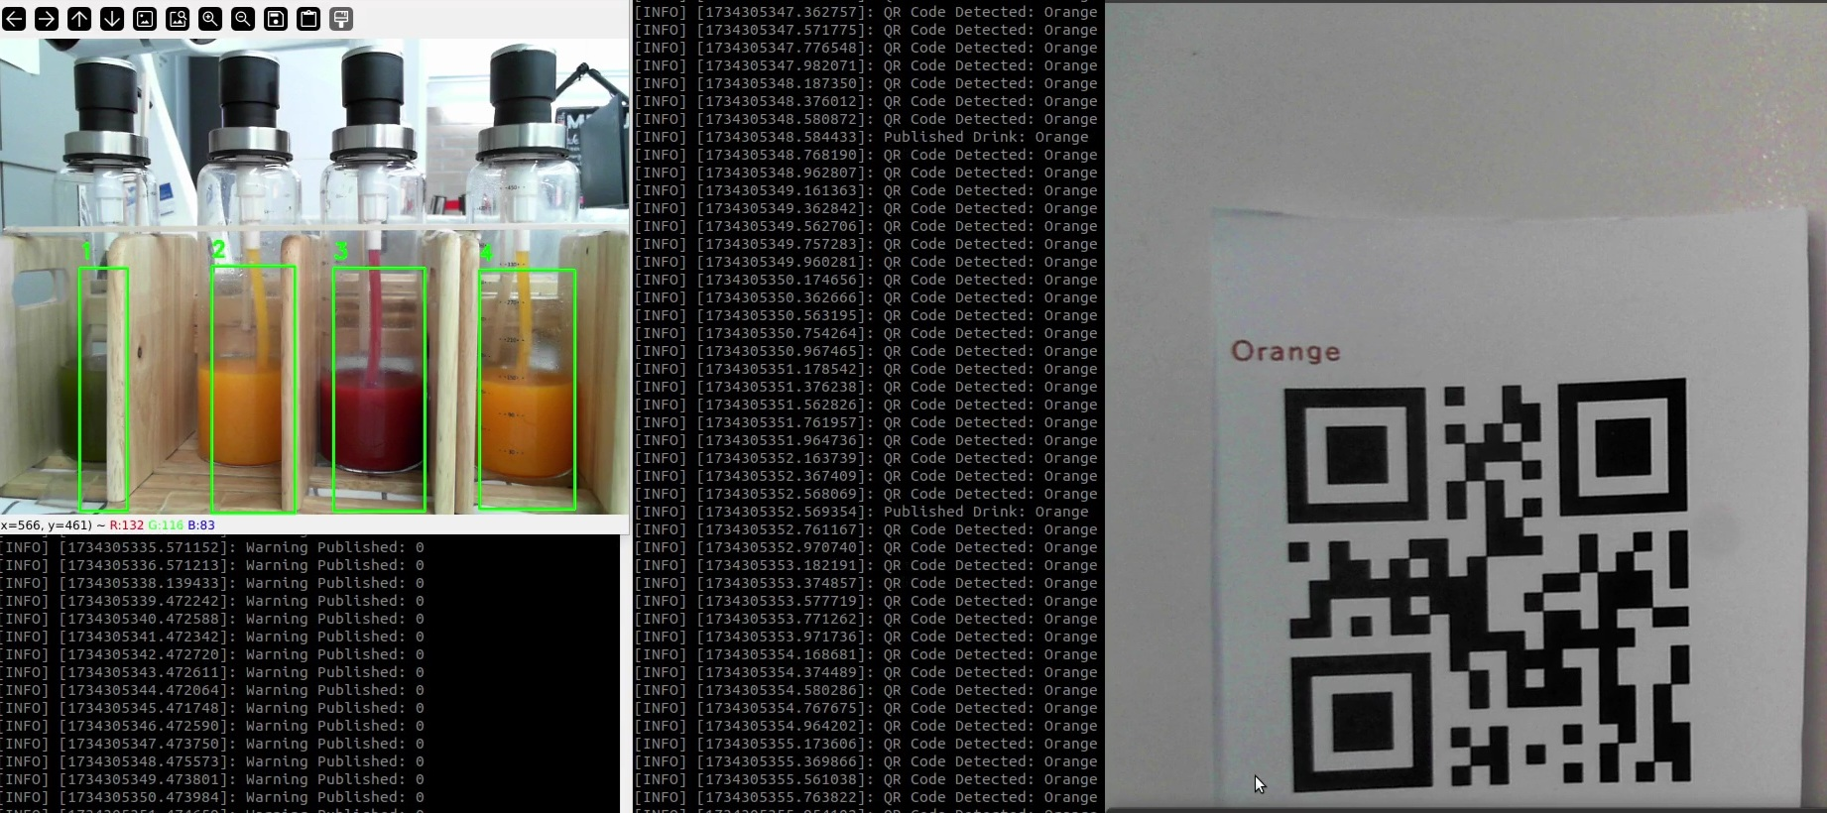
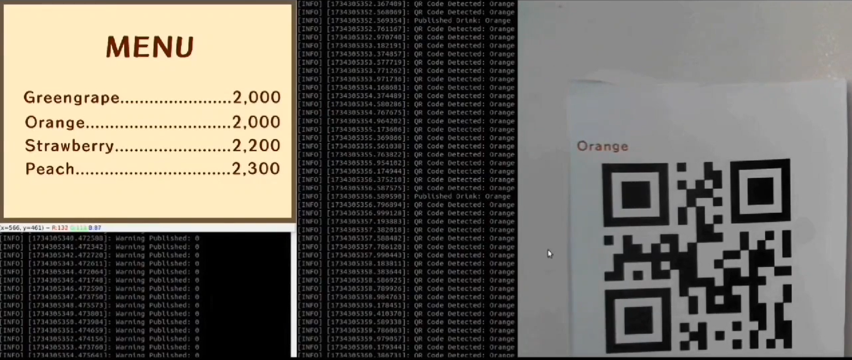
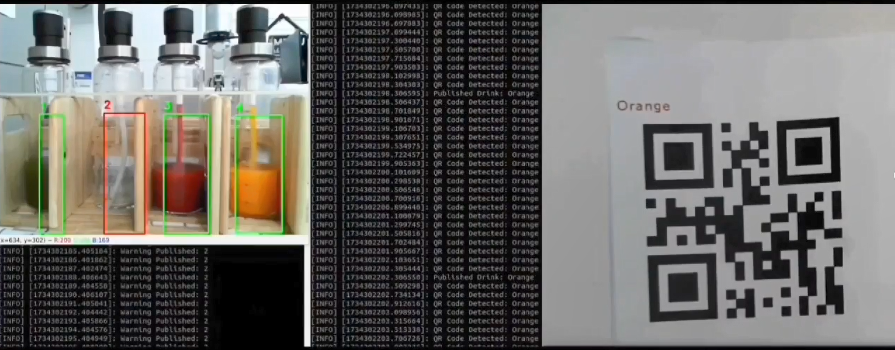
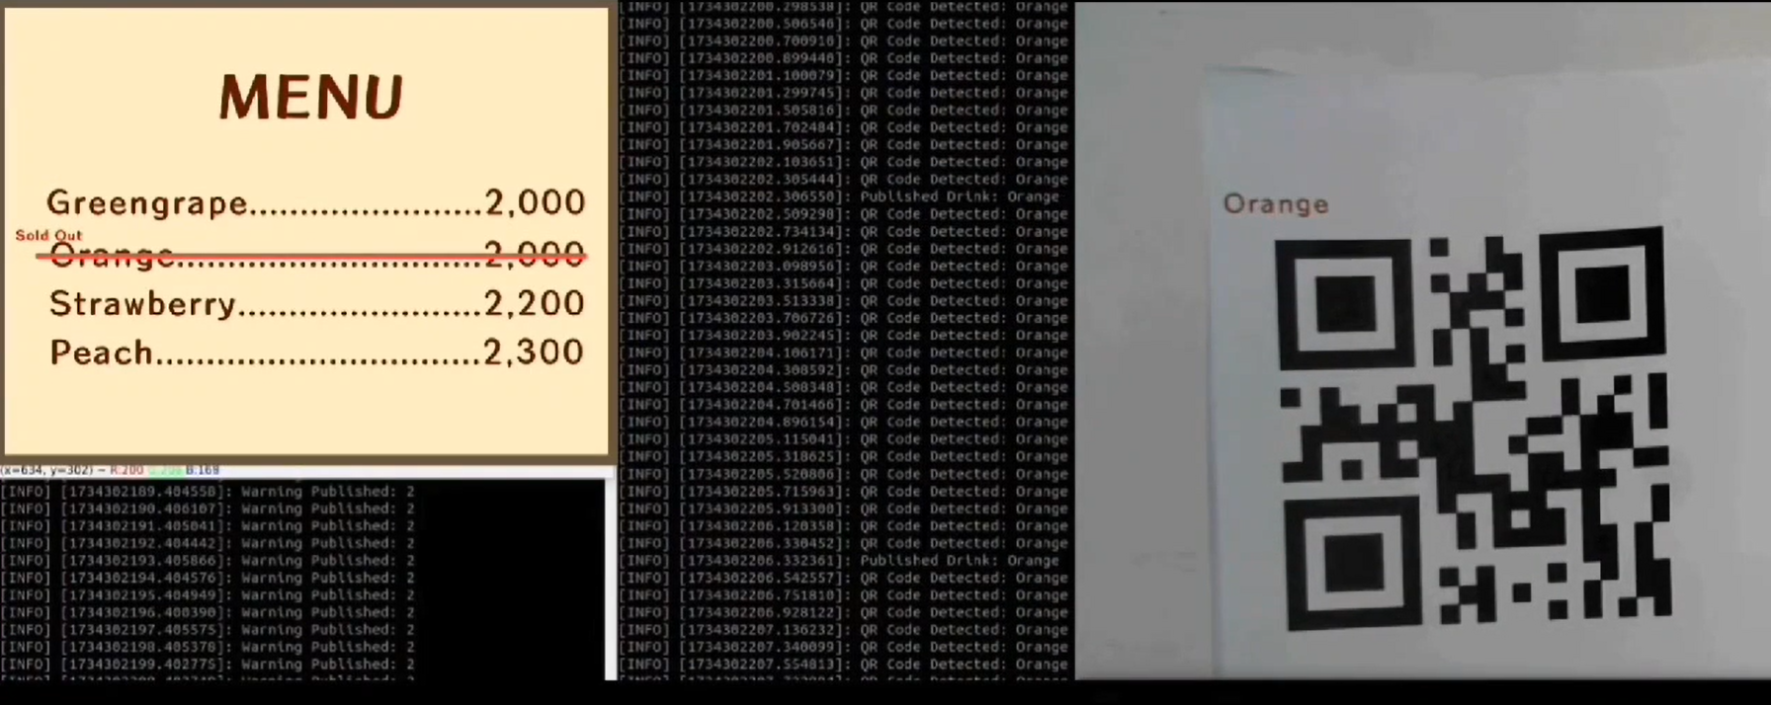
5. Progress
Combine QR classifier &bottle classifier
1. Normal (Empty bottle not occured)
Upon recognition of QR number 30, a public message indicates that the robot is ready to operate
2. Empty bottle not occured (ex 2 orange syrup bottle is empty)
Result of 1: Just print MENU and robot is ready to make drink
Result of 2: Print sold out and robot cannot work

Slide 12
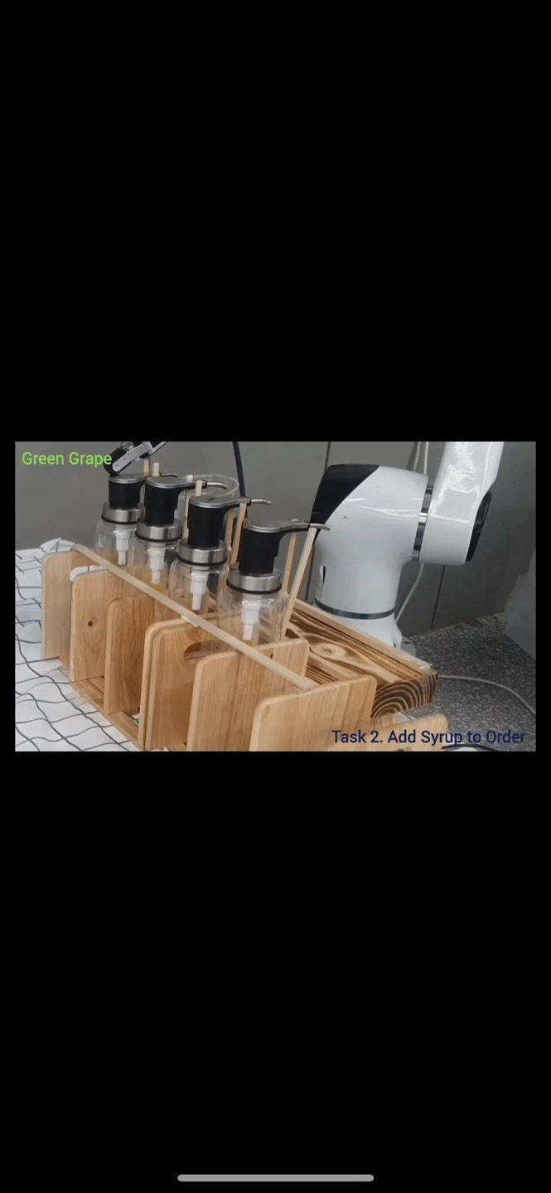

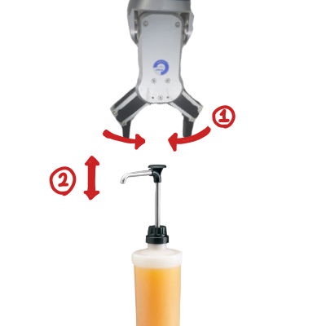
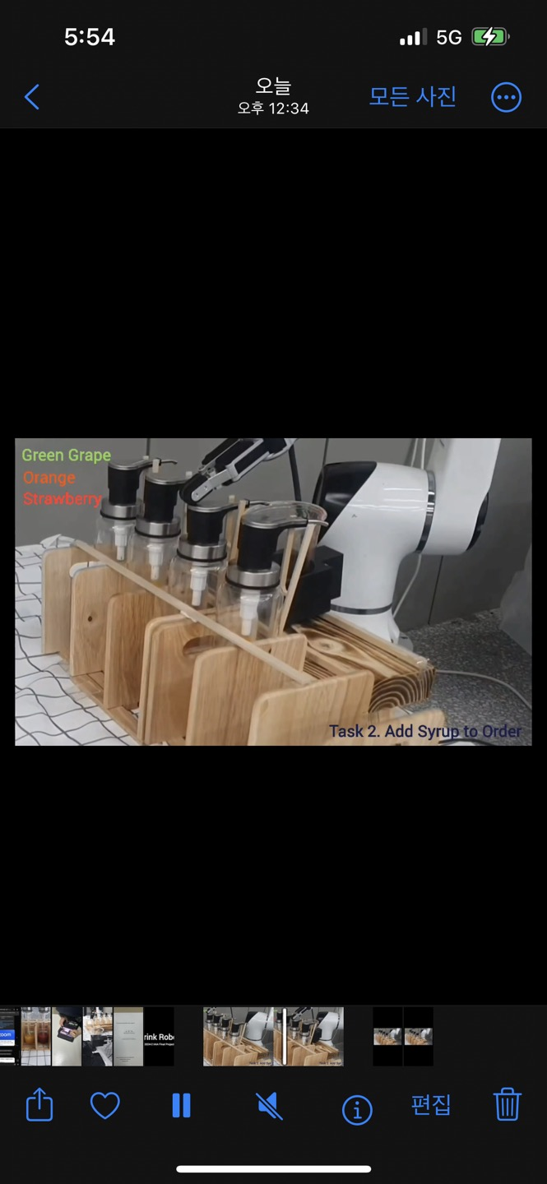
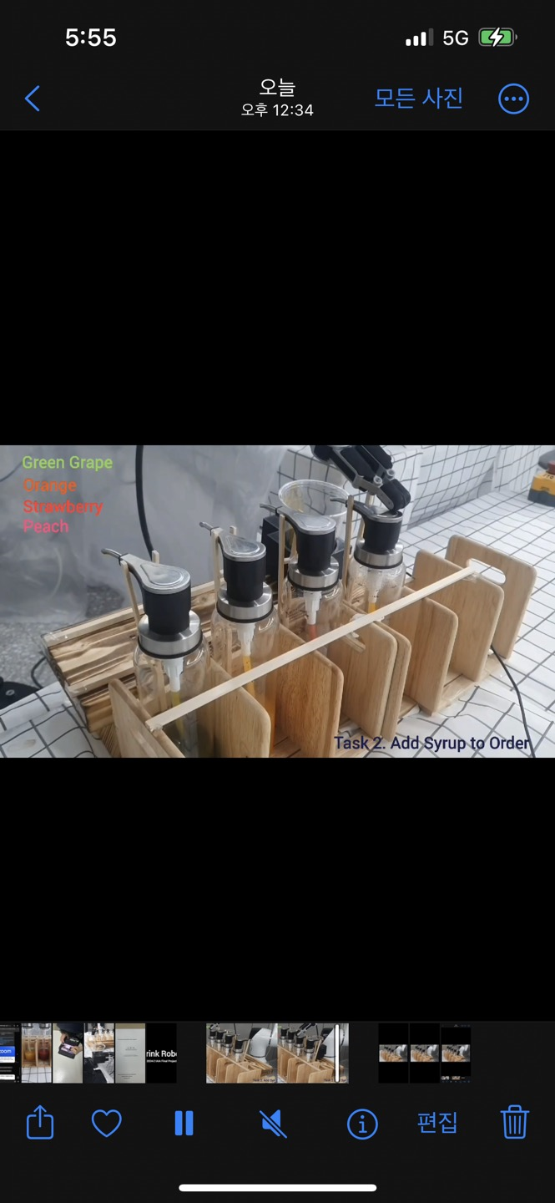
5. Progress
Add syrup recognized by QR code
If there are no empty bottle robot go to syrup and push the syrup recognized by QR code
1. Greengrape detecting | 2. Orange detecting
1. Robot first bottle push | 2. Robot second bottle push
3. strawberry detecting | 4. Peach detecting
3. Robot third bottle push | 4. Robot fourth bottle push
1. greeper squeezing
2. push the syrup

Slide 13
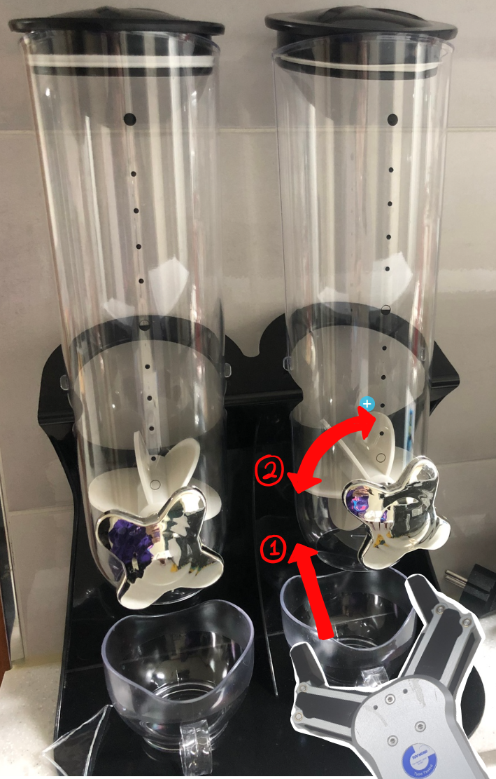
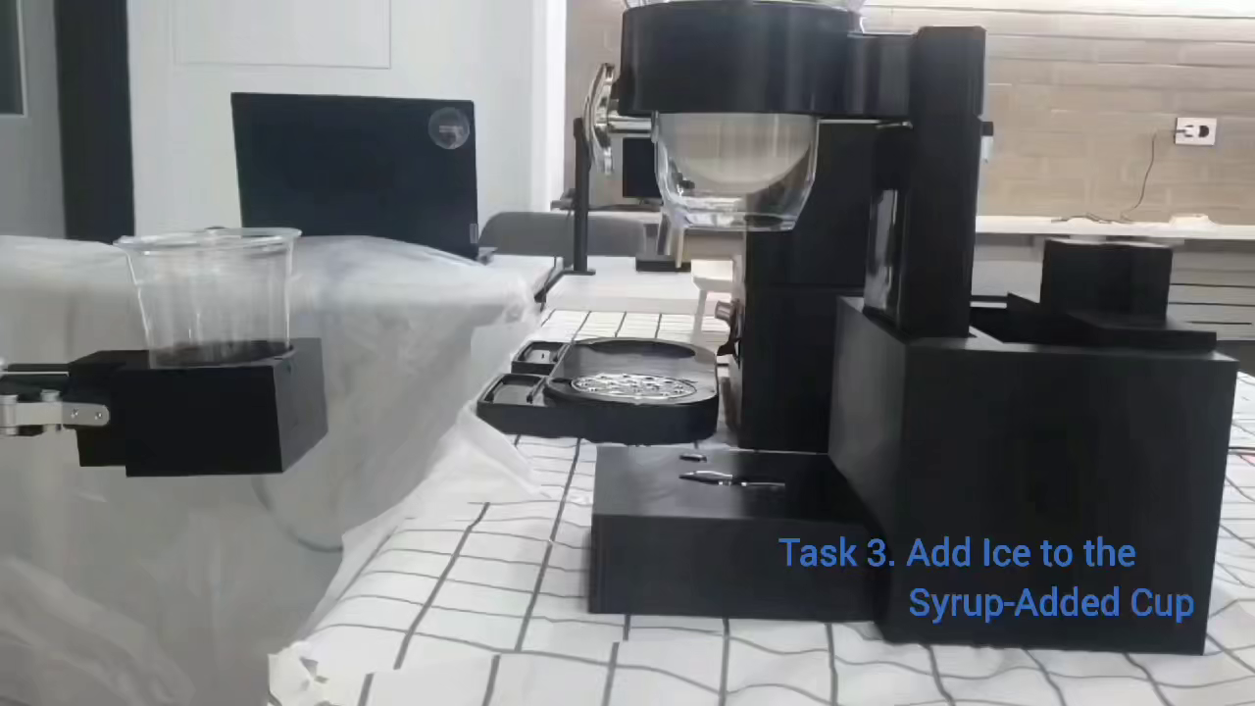
5. Progress
Add ice to the syrup-added cup
After add the syrup robot go to ice dispenser and add ice to the syrup-added cup
1. Turn robot gripper right
2. Turn robot gripper left
Putting ice demo

Slide 14
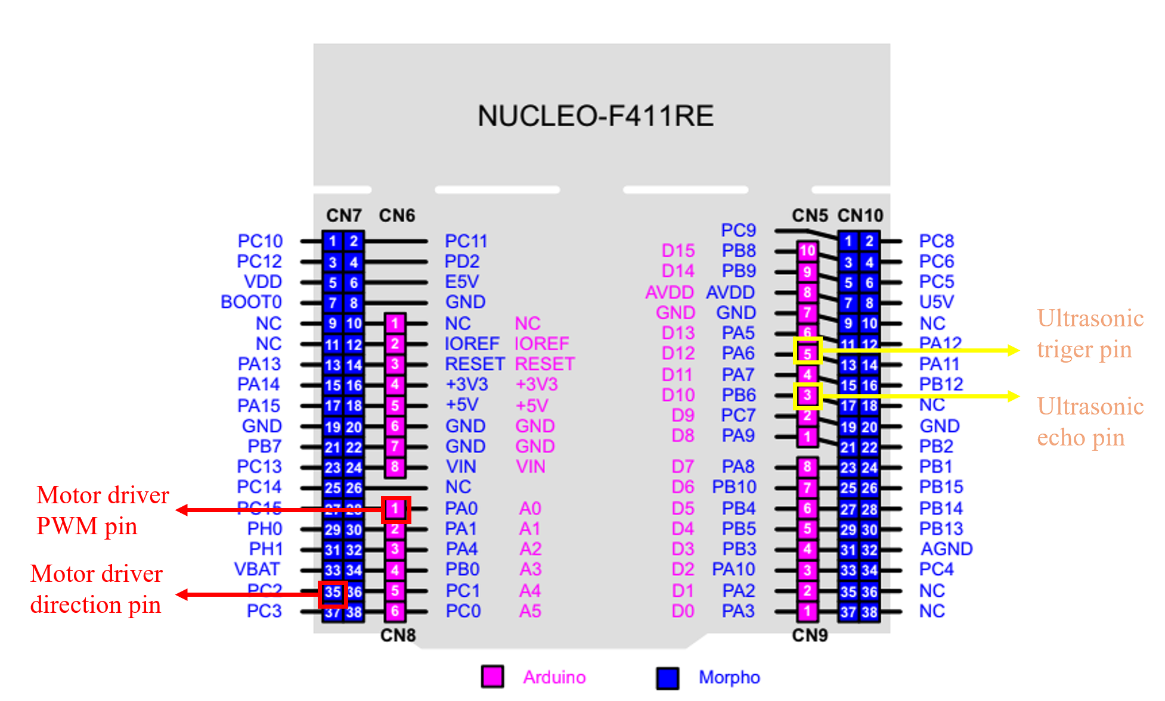
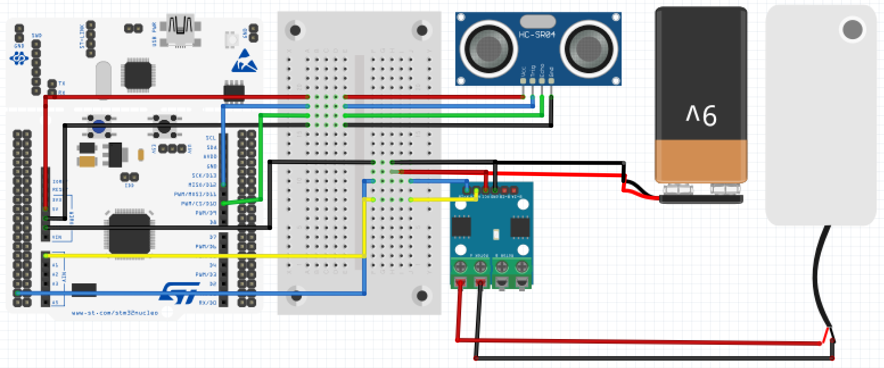
5. Progress
Add cider to a cup of syrup and ice
After put ice dispenser, robot go to cider dispenser. Here, we need to lean about flow dispenser. flow dispenser design is required to allow a constant amount of cider to be released to add cider
1. Flow Dispenser Hardware (Using STM32)
STM32 controls the amount of flow and can recognize objects using ultrasonic sensors

Slide 15
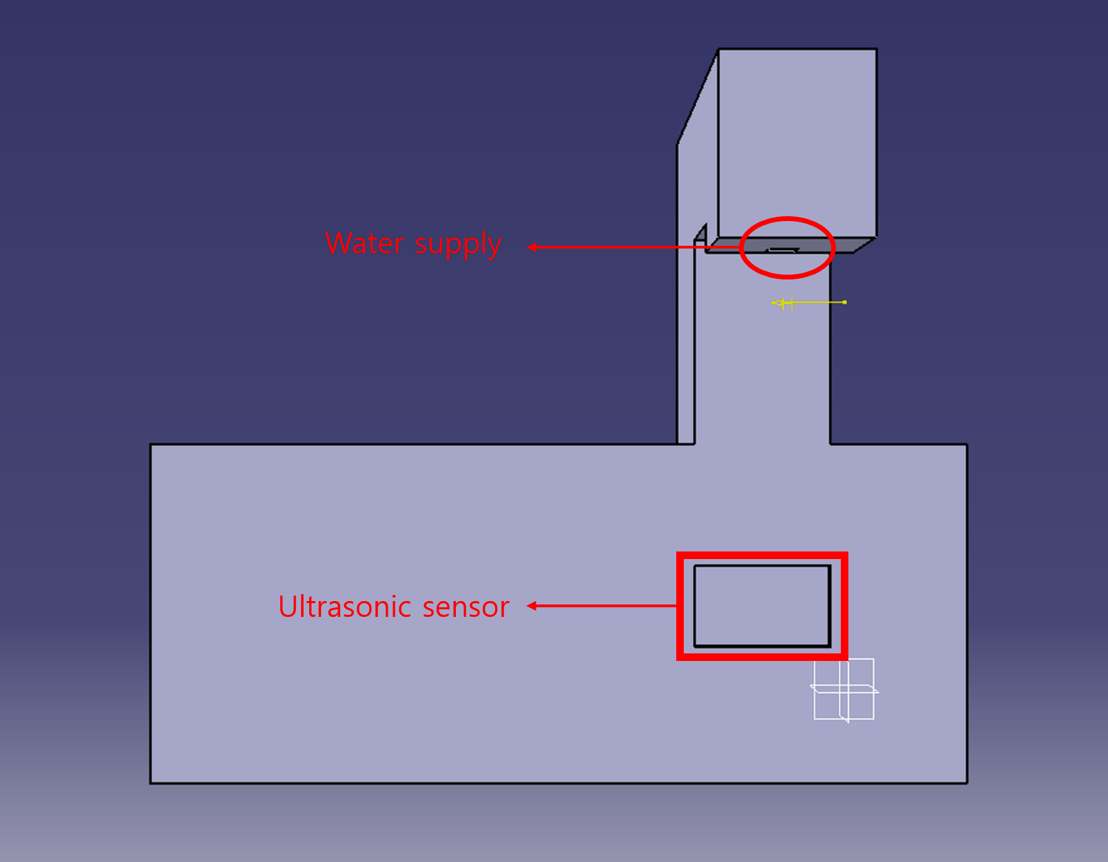
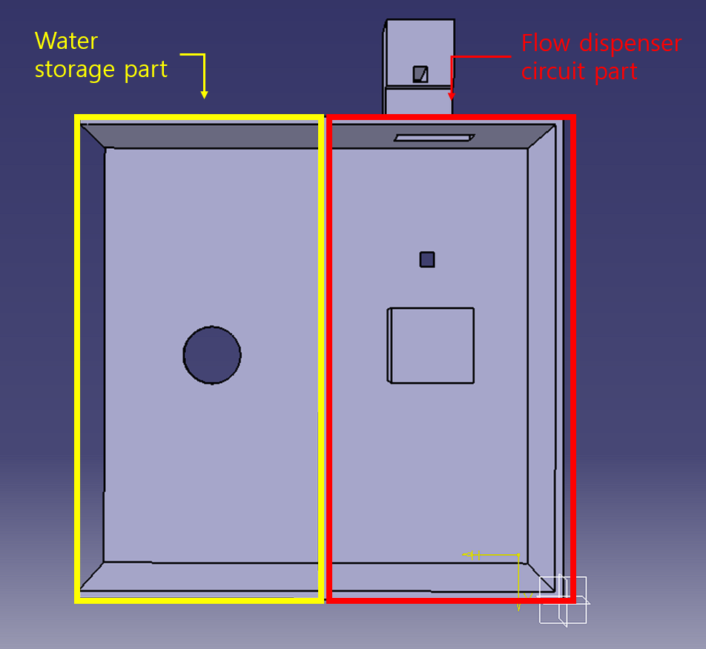
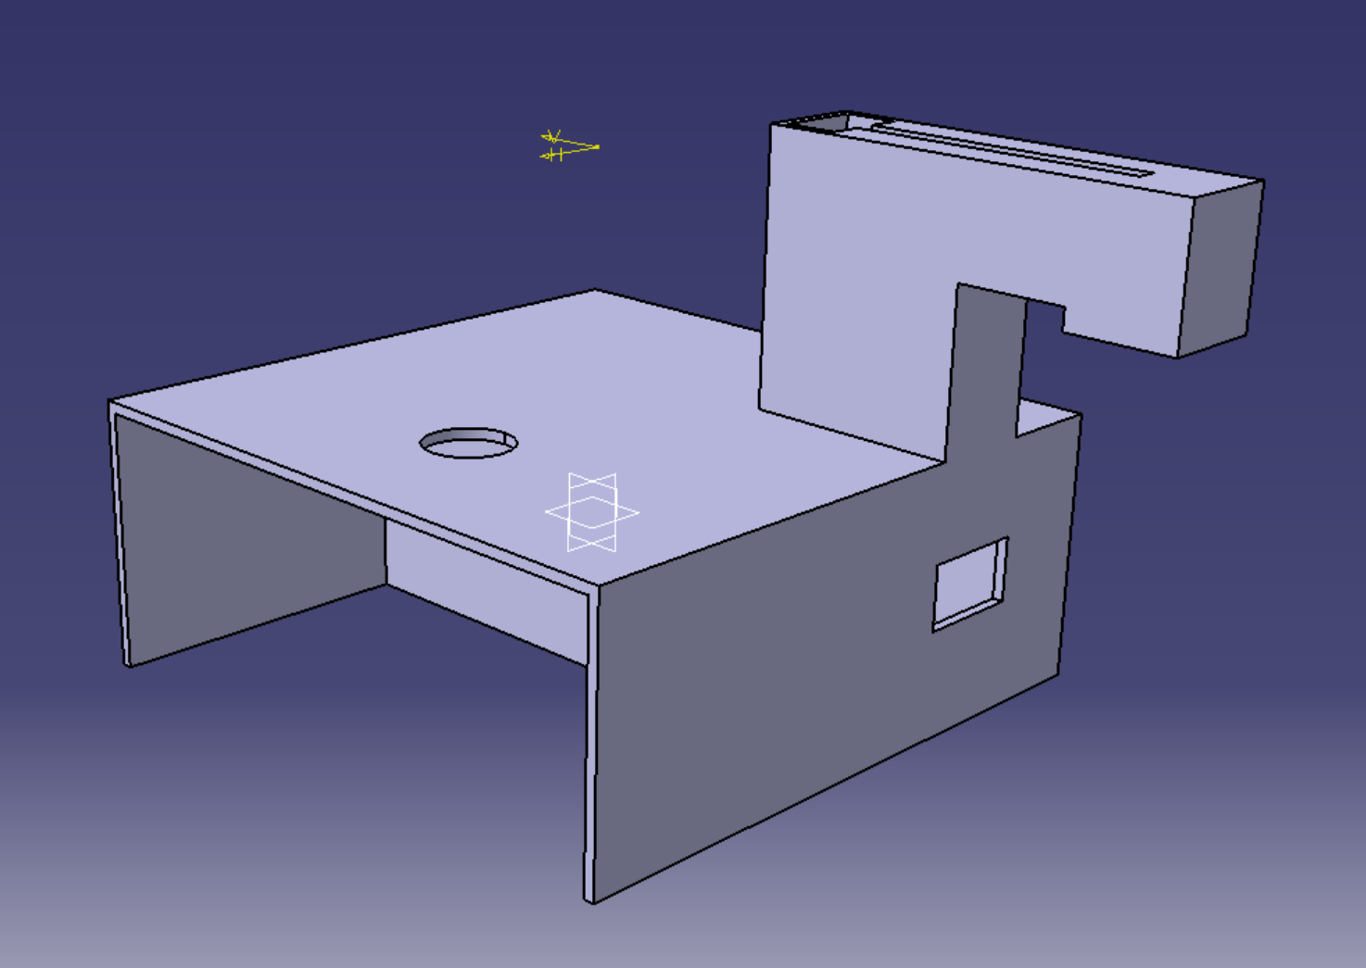
5. Progress
Add cider to a cup of syrup and ice
After put ice dispenser, robot go to cider dispenser. Here, we need to lean about flow dispenser. flow dispenser design is required to allow a constant amount of cider to be released to add cider
1. Flow Dispenser Hardware (Case)
<rear>
<under>
<beside>
A flow dispenser fitted to the sensor is manufactured via Katia

Slide 16
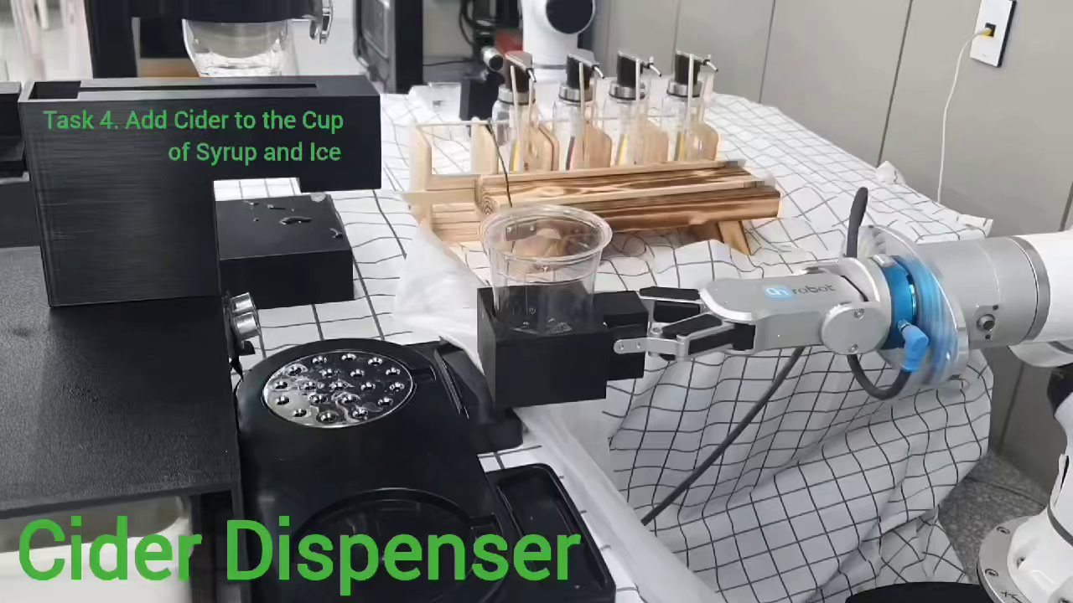
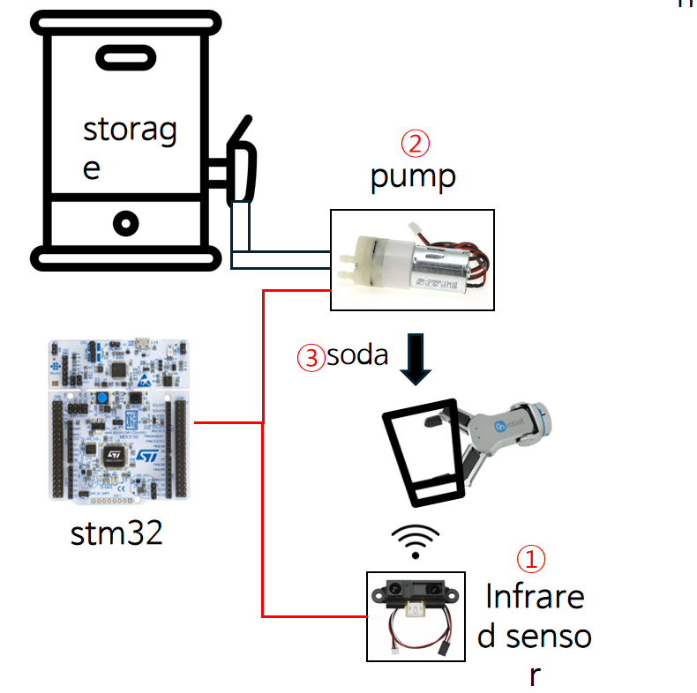

5. Progress
Add cider to a cup of syrup and ice
After put ice dispenser, robot go to cider dispenser. Here, we need to lean about flow dispenser. flow dispenser design is required to allow a constant amount of cider to be released to add cider
2. Flow motion
Storage
Ultrasonic sensor
Putting cider demo

Slide 17
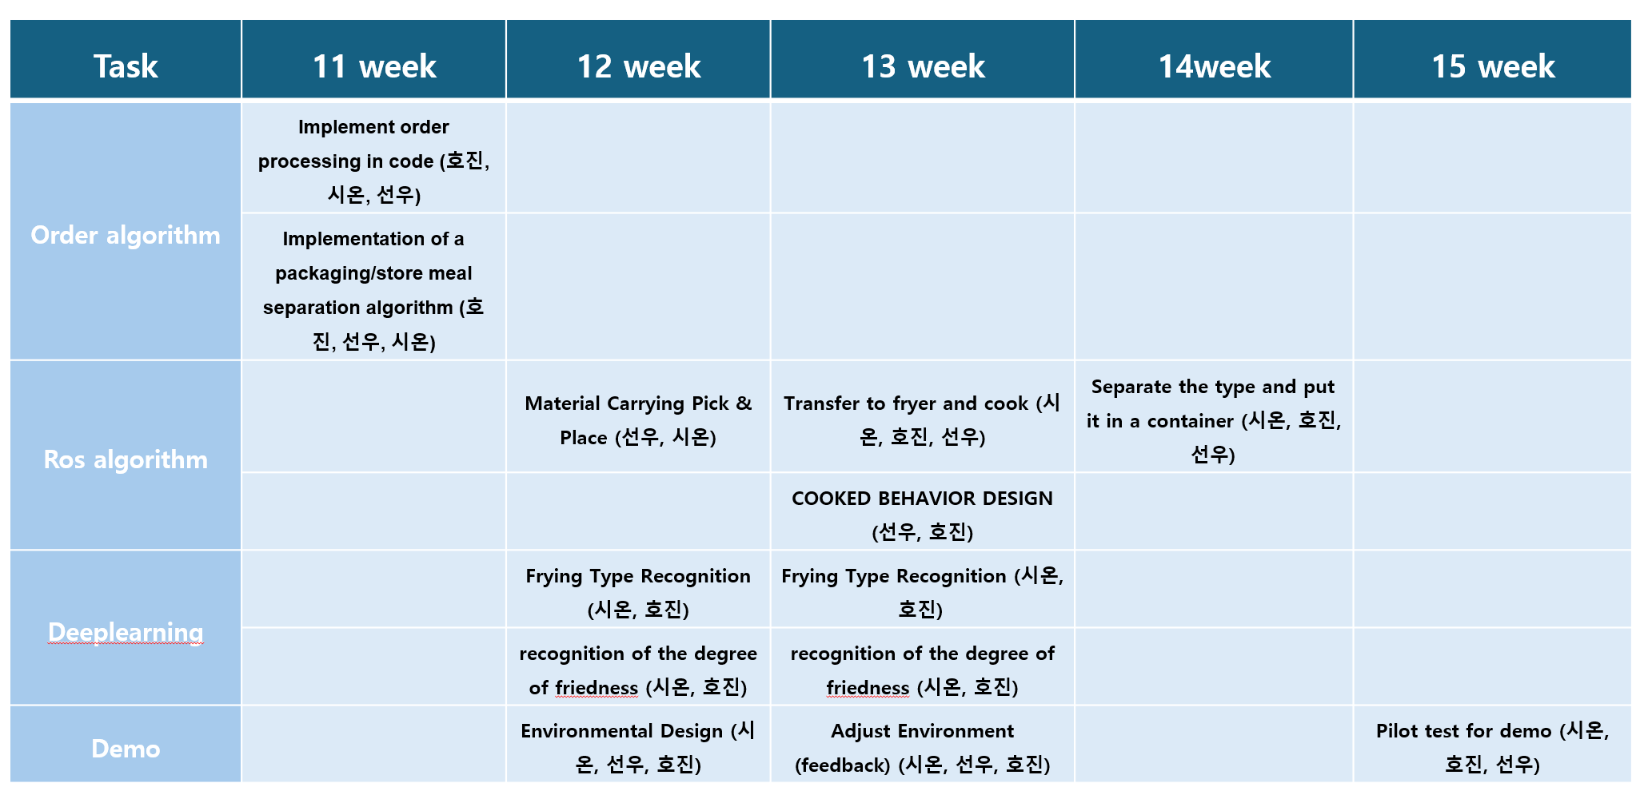

6. Schedule

Slide 18
7. Result
Process | Progress | Complete | Todo
1. Gripper & QR | 100% | Gripper design and manufacturing QR recognition - Test the gripper | - Nothing
2. Add Syrup | 85% | - Building the environment - Syrup process test - Print sold out when the Syrup bottle is empty | - Change the new bottle which contains full of syrup when the syrup is empty
3. Ice dispencer | 100% | - Ice dispenser test - Optimization the environment - Complete & Test demo | -Nothing
4. Putting soda | 100% | - Circuit and code design - Complete & Test demo | -Nothing

Slide 19
8. Disscusion
1.Hardware limitations
2. There are times when a robotic arm radiates
In the case of the Ice dispenser, there is a limit to the melting of the ice over time before turning it, so it must be made quickly before the ice melts.
When the robot is moved to certain coordinates through the correct code, it often causes the robot arm to diverge in an odd direction
Solution
Use or press a water stand used in a water purifier to improve it with an equipment that produces ice
Cause
Although the exact reason was not found, it is estimated that the equipment was turned on for too long, or that ROS used a lot of time information, causing inconsistencies due to poor time synchronization at each node.

Slide 20
9. References
Coffee Bean Market Share, Size, Trends & Analysis, 2032
로봇 에이드 카페 - 협동로봇 적용 사례

